Slide 1
Ready Pizza
(ONLINE PIZZA DELIVERY)

Slide 2
INTRODUCTION
Computers have become part of the life for accessing almost any kind of information. Life in the 21st century is full of technological advancement and in this technological age it is very difficult for any organization to survive without utilizing technology.
Online pizza delivery allows the customers to choose the pizza by making their own order choosing size, cheese, sauce and toppings.
This makes customers sit at home and order pizza with their requirements.
Customer has to register and login before making an order and make an online payment. If payment is successful order is placed successfully and delivered with in 30 min.

Slide 3
OBJECTIVE
Build your own pizza – This system will help customers in ordering custom pizzas. So the customer will pick exactly the things which he/she wants in their pizza. This will surely enhance the image of the pizzeria and customer satisfaction will be more.
Online Payment- This system will give option to the customer for online payment. This will make pizza buying experience cash free.
Reduce Paper Work- As most of the things will be performed online, it will reduce the usage of paper for the pizzeria.
Improves Efficiency- This system will make things easier for staff as whole ordering process is done by customer only. These were the objectives of the online pizza ordering System.

Slide 4
LANGUAGES USED
HTML (Hyper Text Markup Language) is the standard markup language for creating web pages and web applications. With Cascading Style Sheets (CSS) and JavaScript it forms a triad of cornerstone technologies for the World Wide Web. Web browsers receive HTML documents from a webserver or from local storage and render them into multimedia web pages. HTML describes the structure of a web page semantically and originally included cues for the appearance of the document.
HTML elements are the building blocks of HTML pages. With HTML constructs, images and other objects, such as interactive forms, may be embedded into the rendered page. It provides a means to create structured documents by denoting structural semantics for text such as headings, paragraphs, lists, links, quotes and other items

Slide 5
PHP
PHP (recursive acronym for PHP: Hypertext Preprocessor) is a widely-used open source general-purpose scripting language that is especially suited for web development and can be embedded into HTML
JAVASCRIPT
JavaScript often abbreviated as "JS", is a high-level, dynamic, untyped, and interpreted run-time language. It has been standardized in the ECMAScript language specification. Alongside HTML and CSS, JavaScript is one of the three core technologies of World Wide Web content production; the majority of websites employ it, and all modern Web browsers support it without the need for plug-ins.

Slide 6
SOFTWARE USED
XAMPP
XAMPP is a free and open source cross-platform web server solution stack package developed by Apache Friends, consisting mainly of the APACHE Server, MariaDB database, and interpreters for scripts written in the PHP and Perl programming languages. XAMPP stands for Cross-Platform (X), Apache (A), MariaDB (M), PHP (P) and Perl (P). It is a simple, lightweight Apache distribution that makes it extremely easy for developers to create a local web server for testing and deployment purposes

Slide 7
PANLES:
User panel
Admin panel

Slide 8
USER PANEL
Here user can be able to order a pizza with his requirements like size,toppings etc..
Some screen shots are placed in next slides to get more clarity how the user panel looklikes.

Slide 9
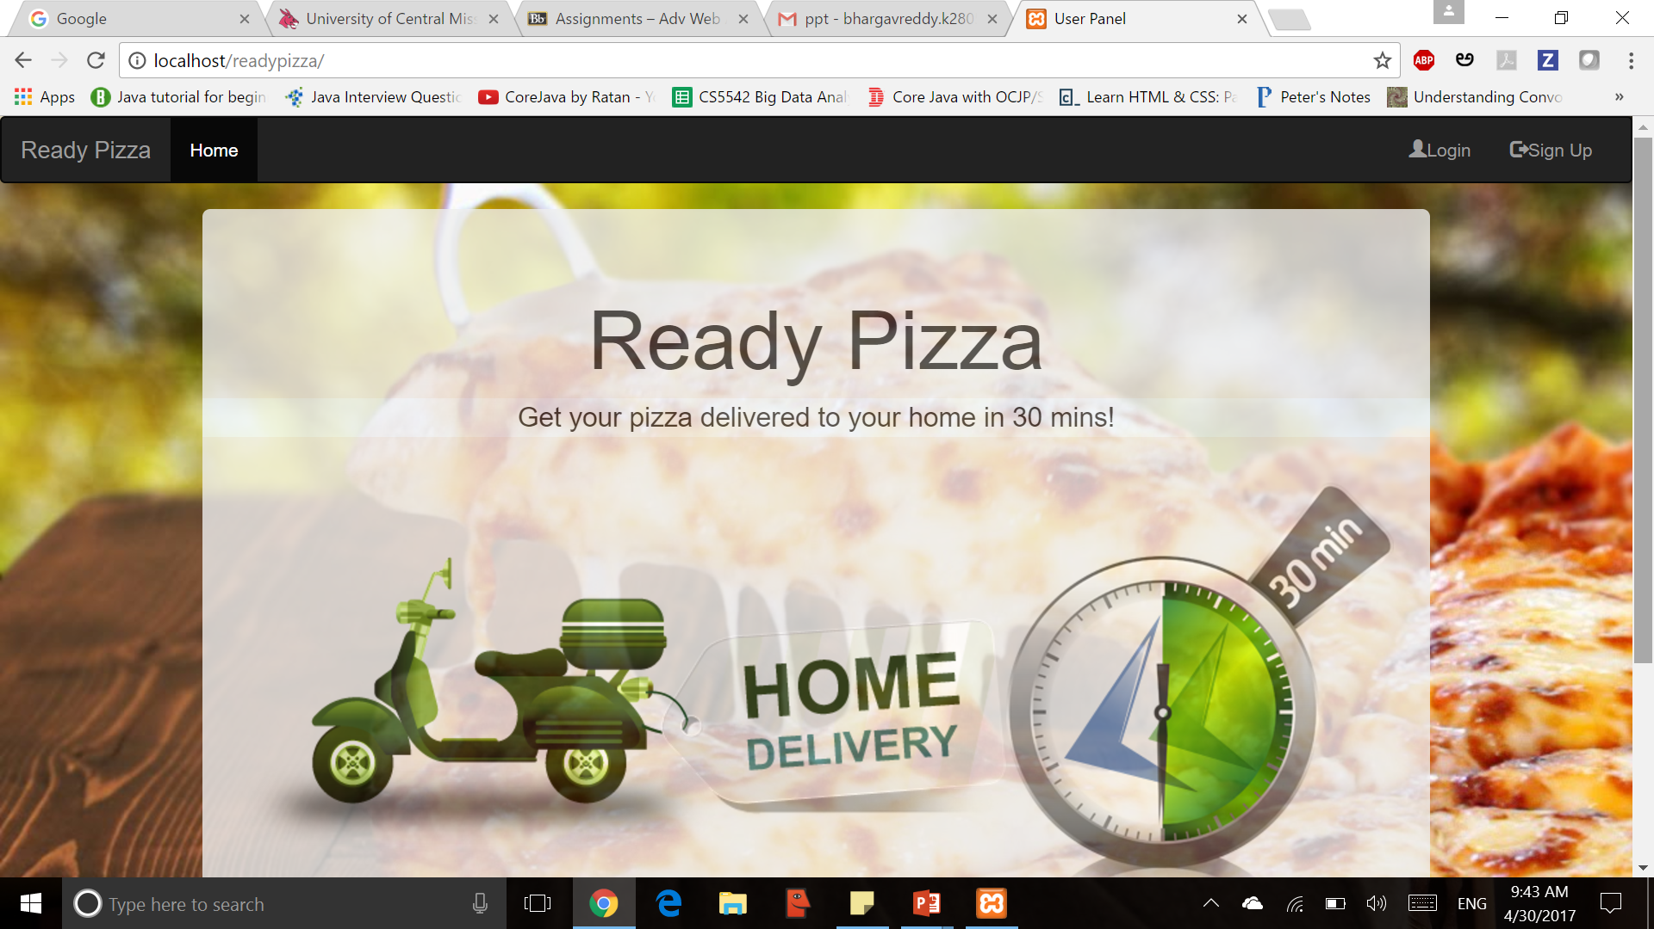

USER PANEL
HOME PAGE
AFTER LOGIN USERHOME PAGE

Slide 10
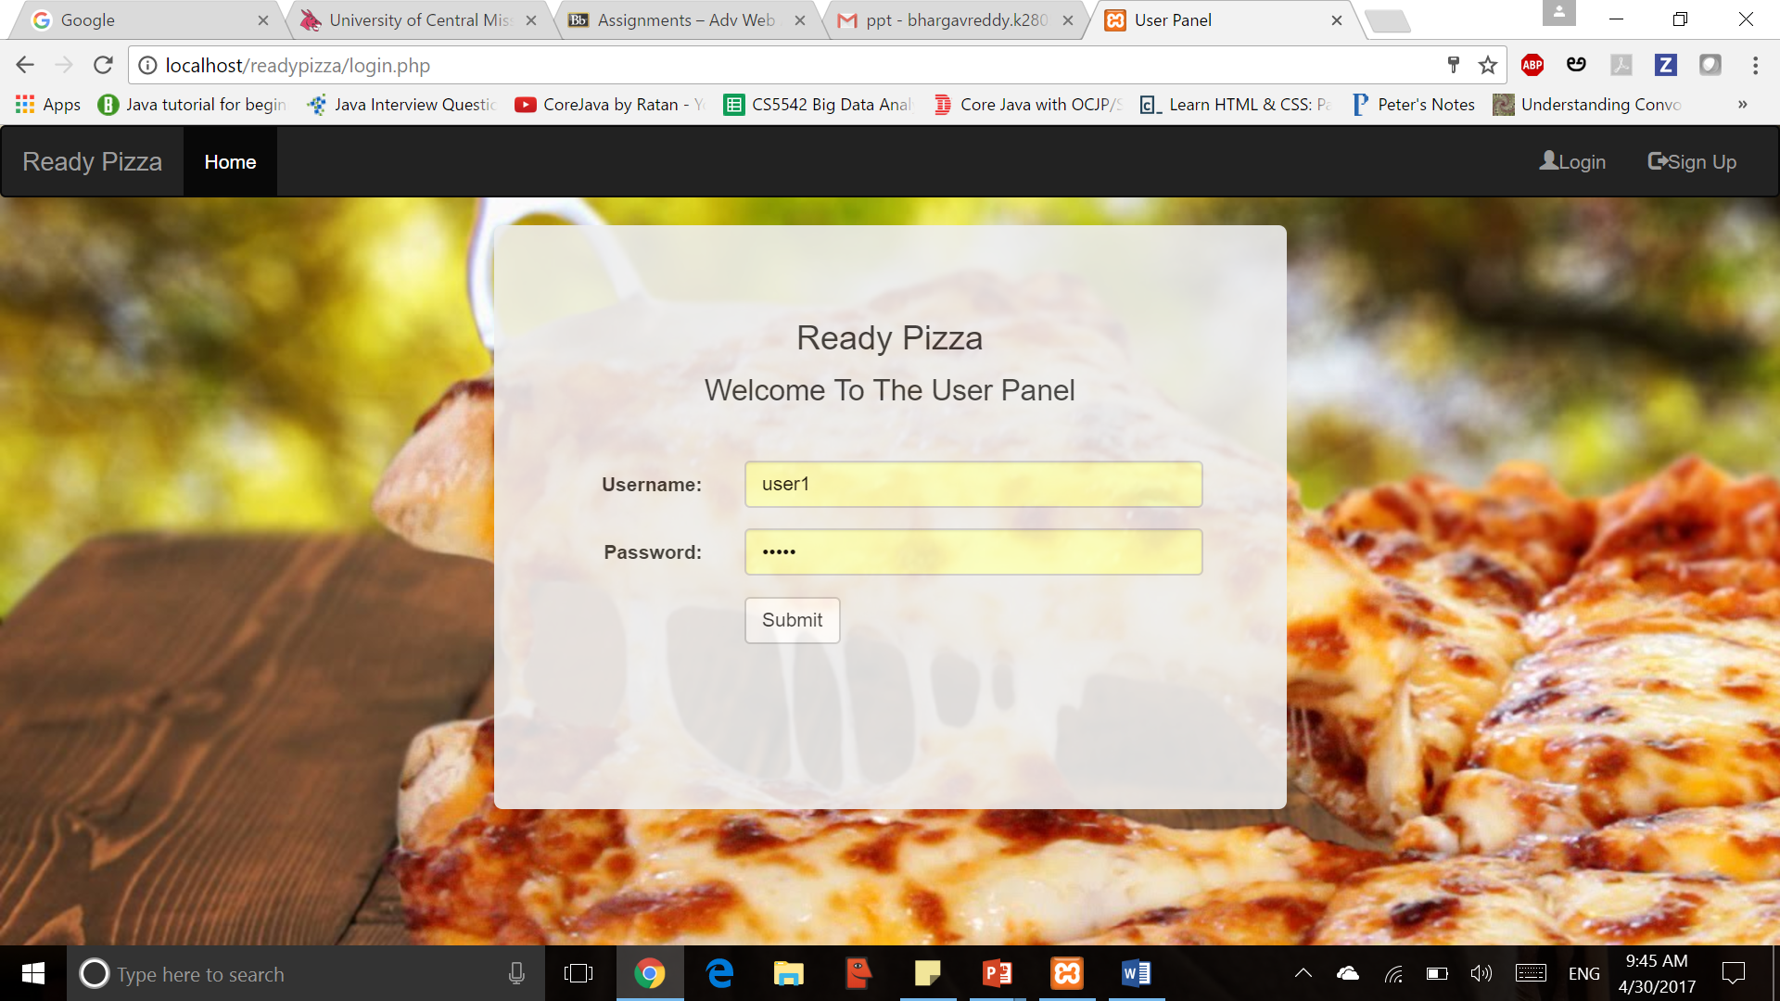
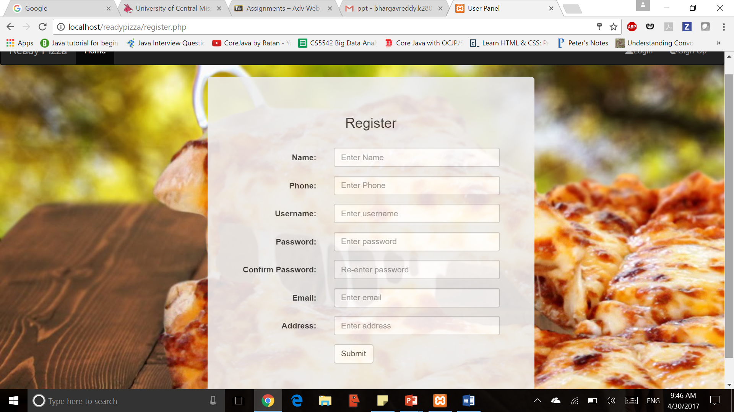
USER PANEL
Login page
REGISTRATION PAGE

Slide 11
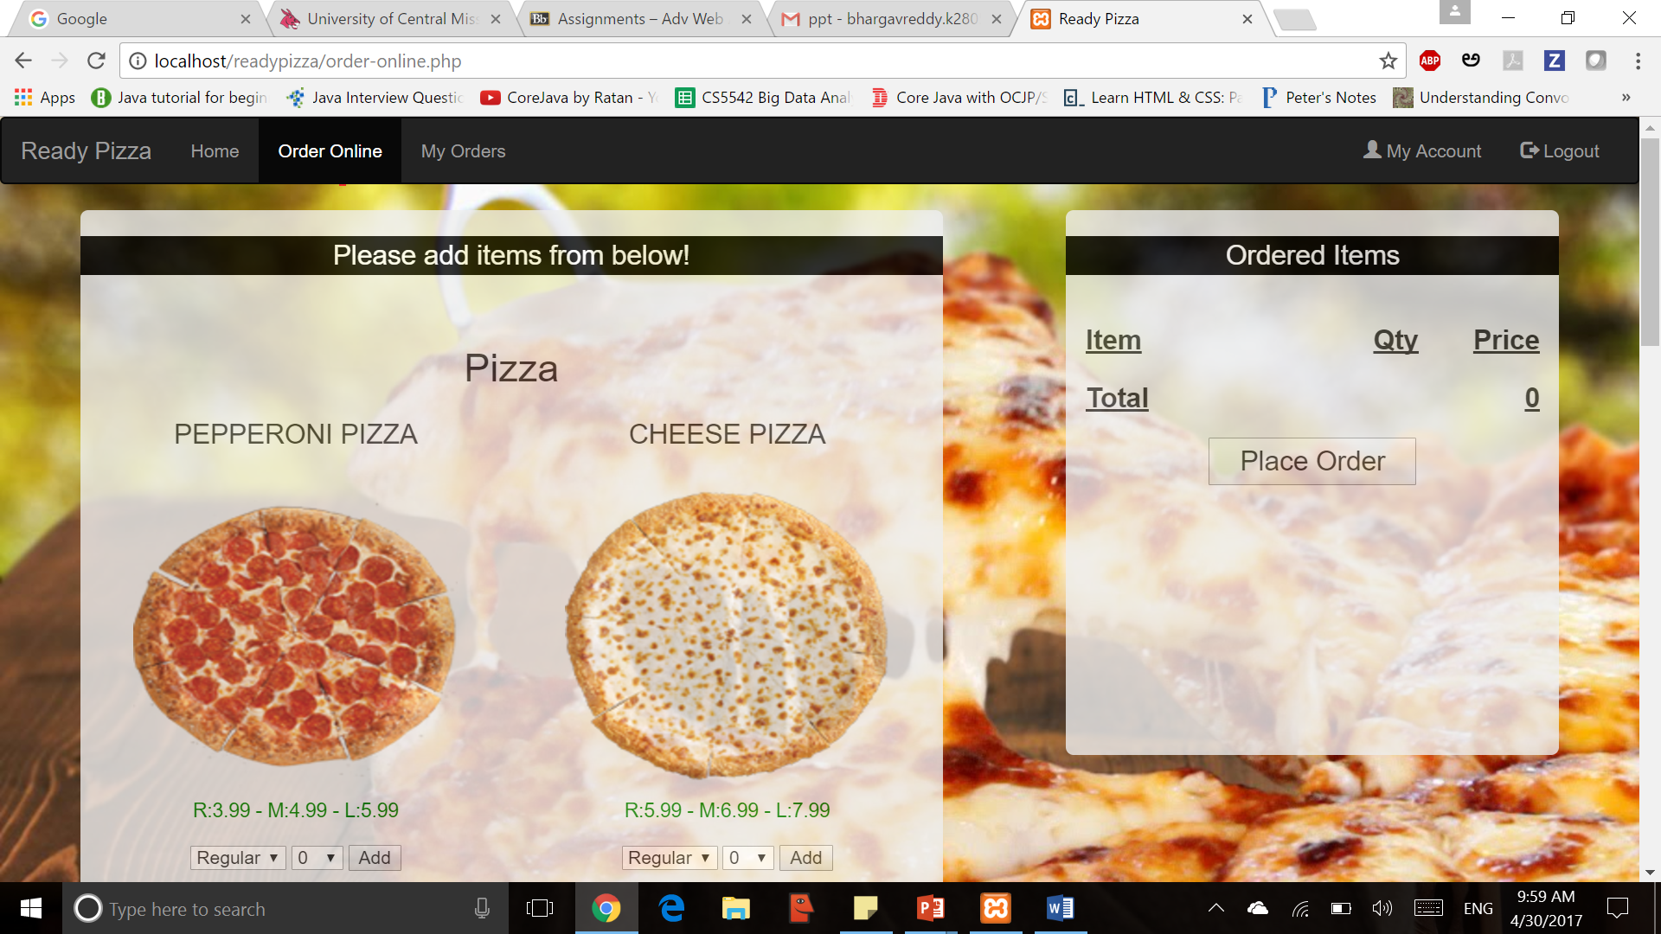
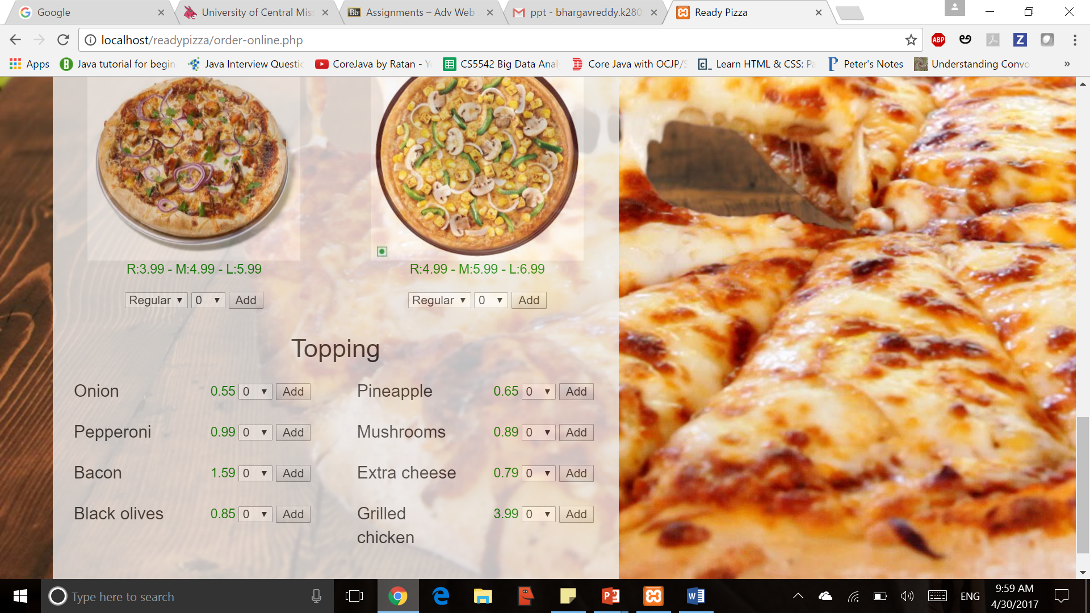
ORDER ONLINE PAGE
1ST HALF SCREEN
2ND HALF SCREEN

Slide 12
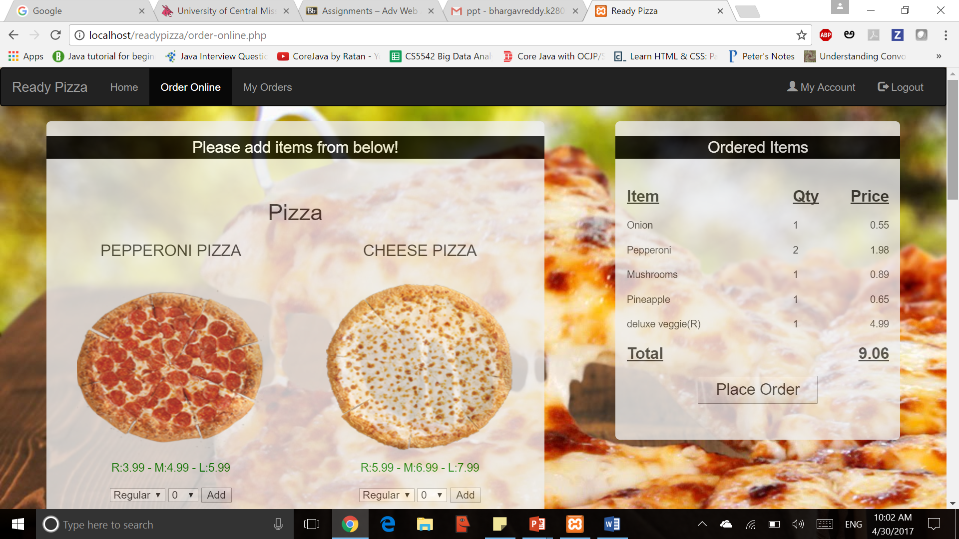
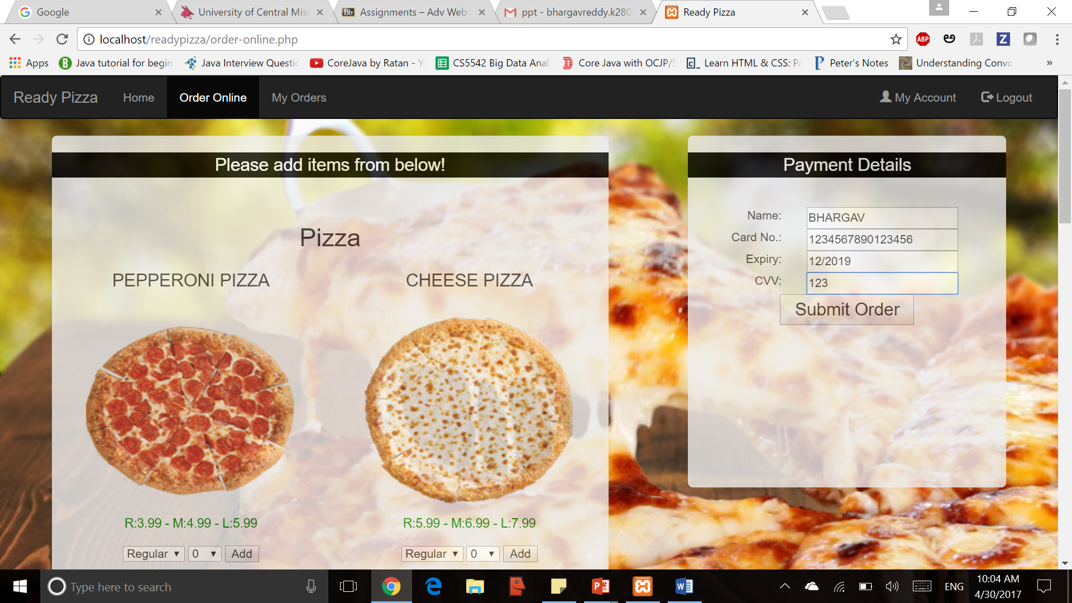
USER PANEL
ADDING SIZE,TOPPINGS
AFTER PLACING ORDER

Slide 13
ADMIN PANEL
Admin can be able do the following operation
Add, view and edit user
Add, view and edit pizza
Add, view and edit toppings
Orders management
Able to view the reports
Some screen shots are provided in next slides for better understanding

Slide 14
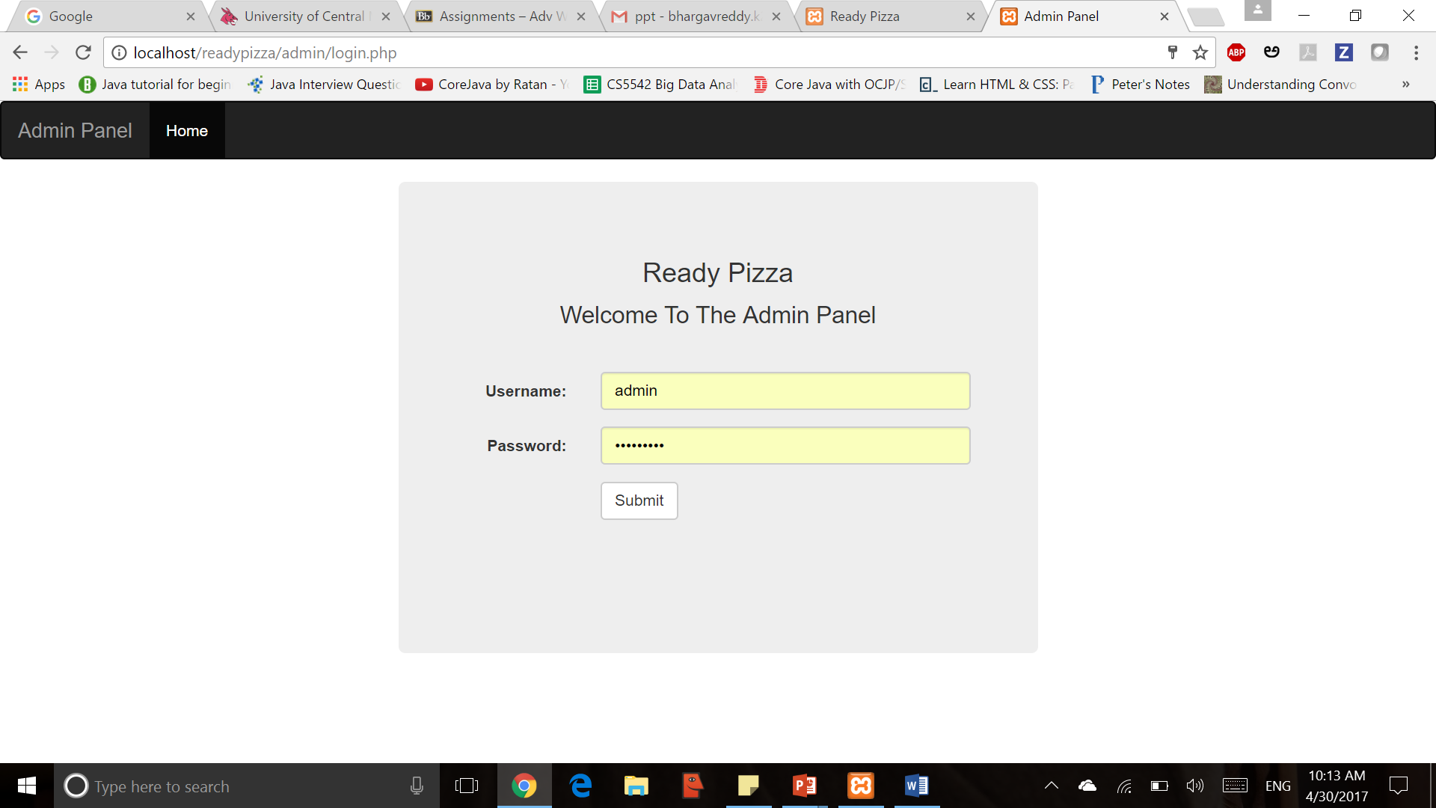
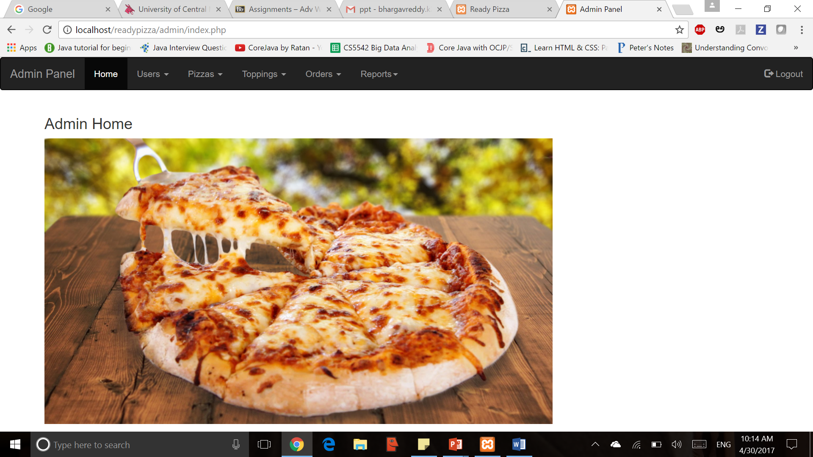
ADMIN PANEL
ADMIN LOGIN PAGE
ADMIN HOME PAGE

Slide 15
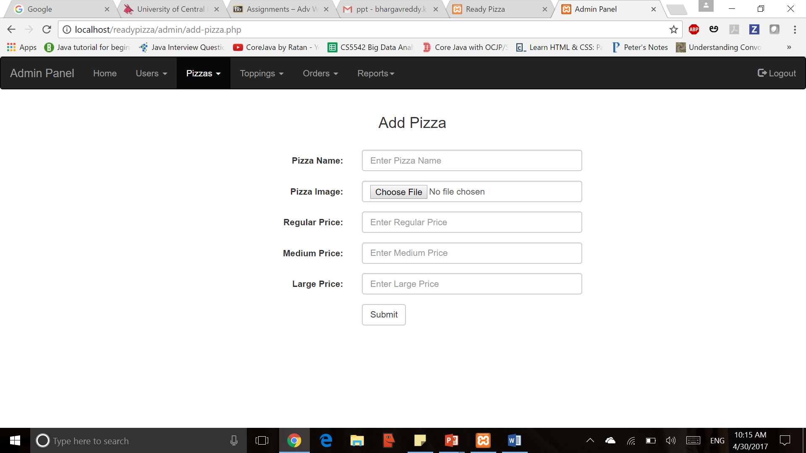
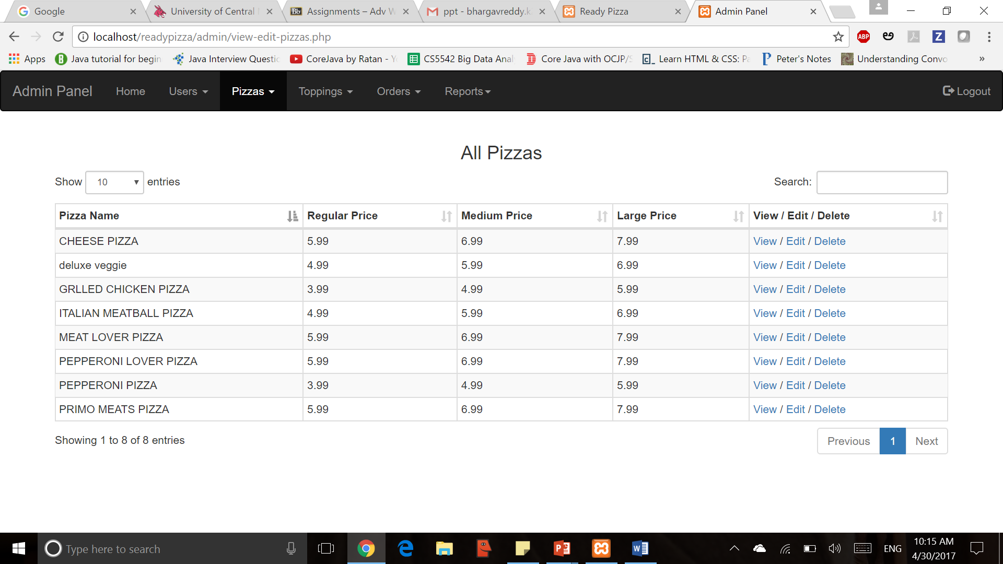
ADMIN PANEL
ADD PIZZA
VIEW/EDIT PIZZA

Slide 16
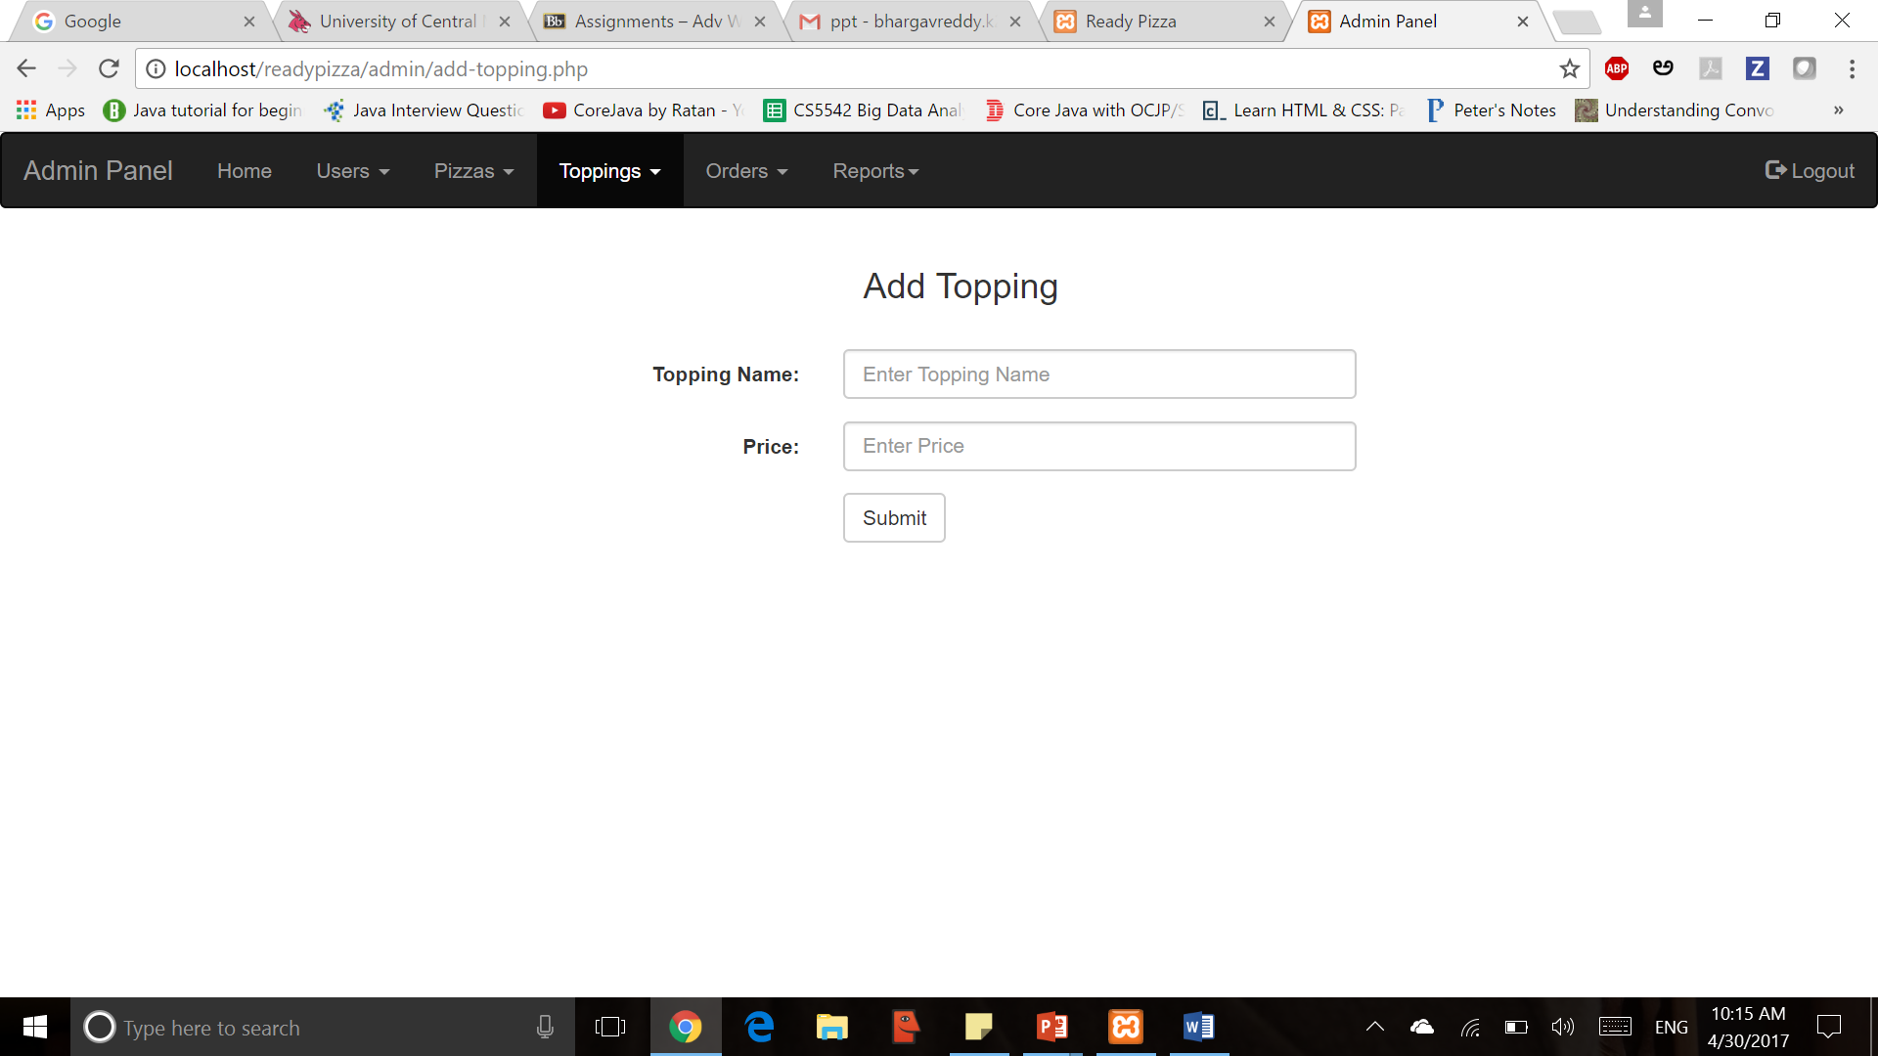
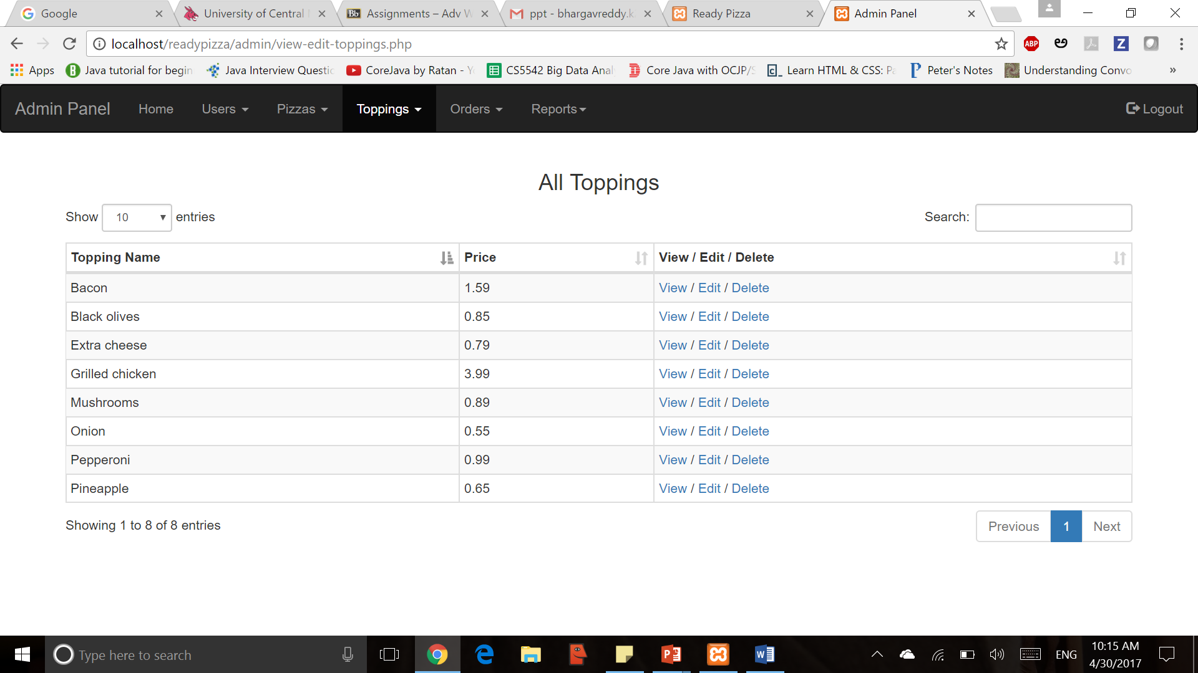
ADMIN PANEL
ADD TOPPING
VIEW/EDIT TOPPING

Slide 17
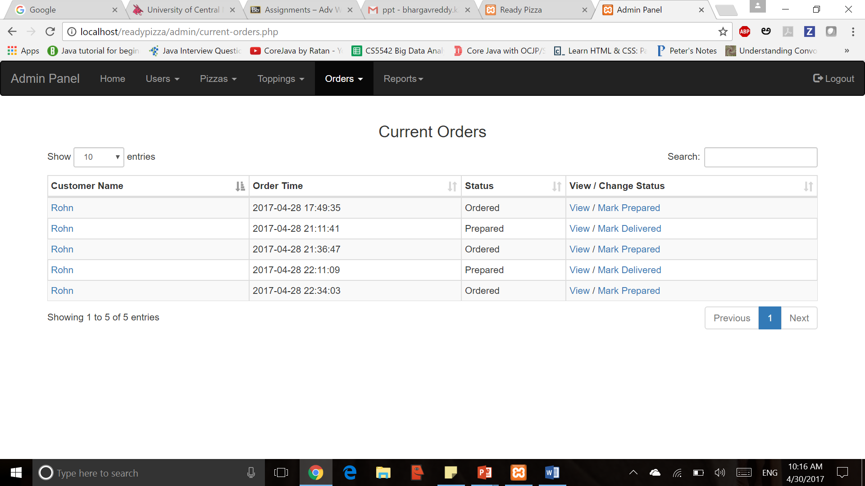
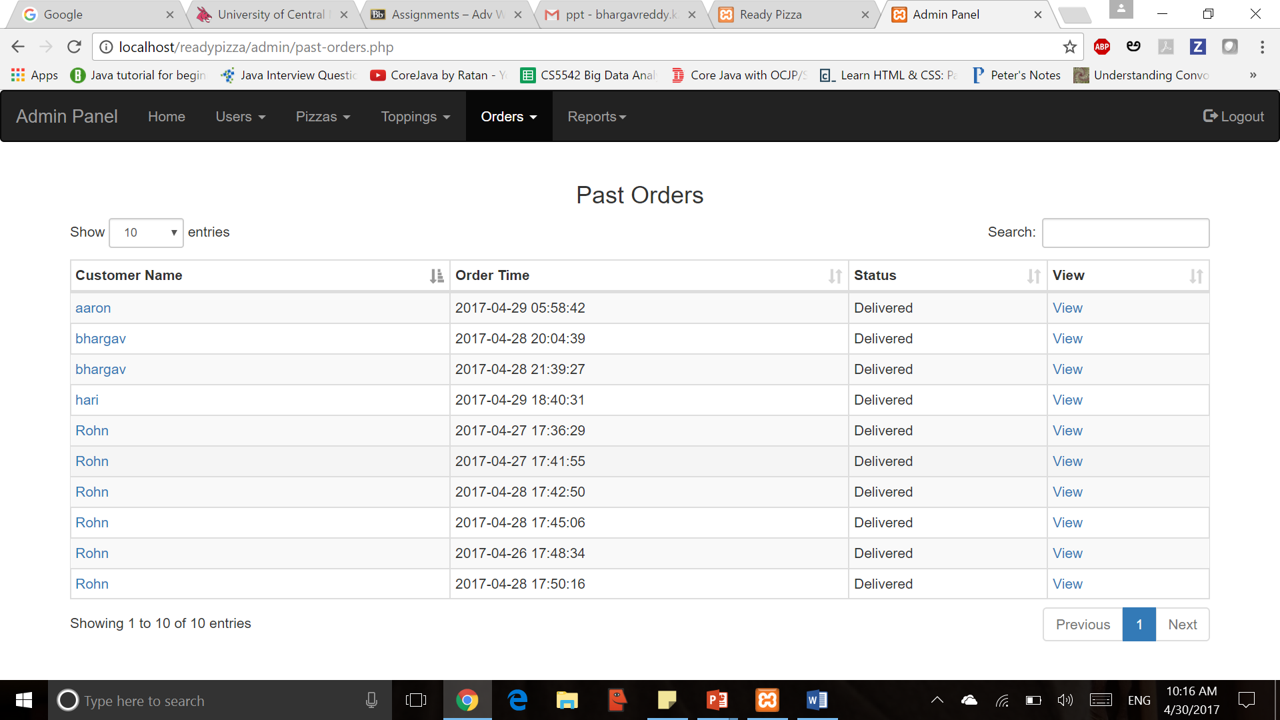
ADMIN PANEL
CURRENT ORDERS
PAST ORDERS

Slide 18
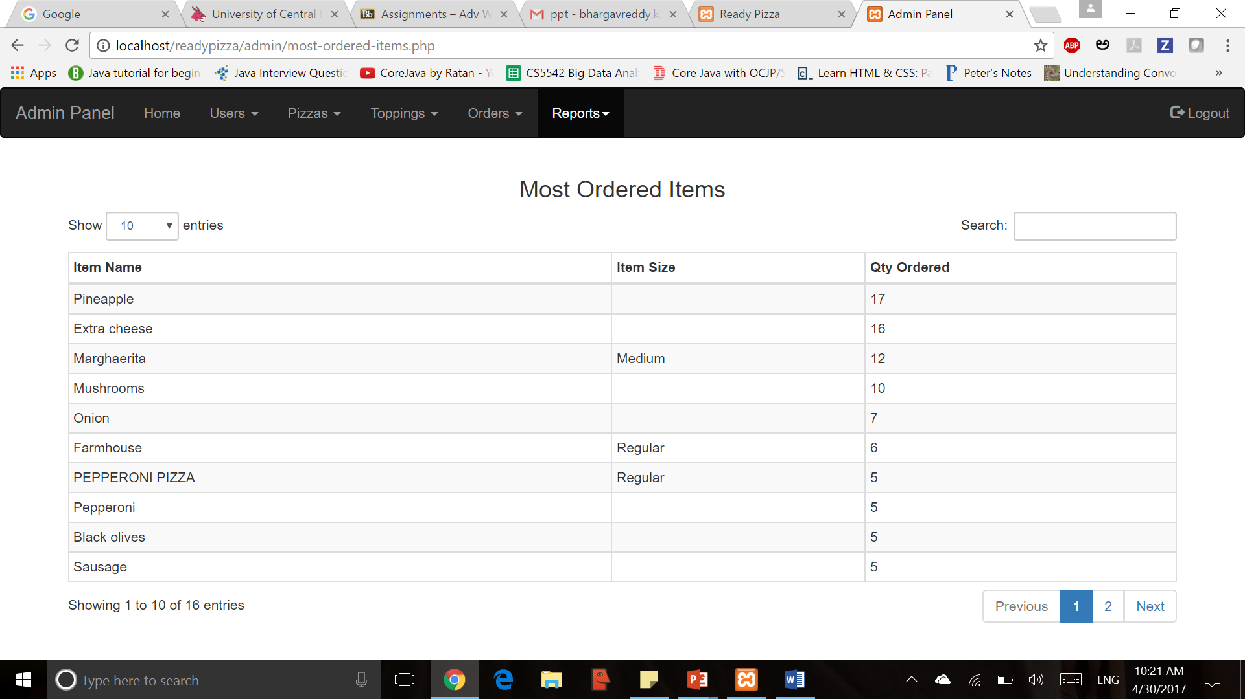
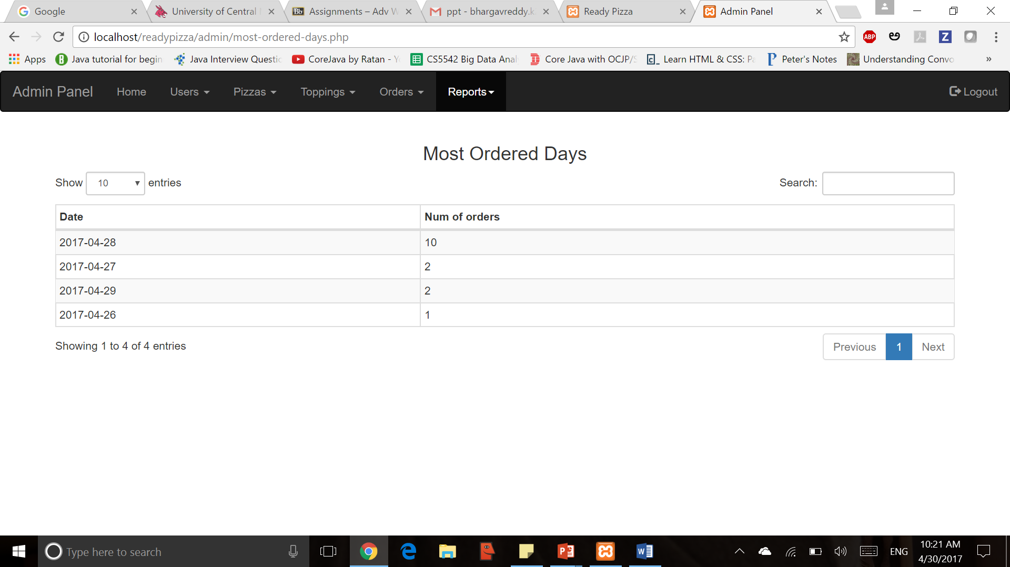
ADMIN PANEL
REPORTS
REPORTS

Slide 19
KEY CHALLENGES
Maintaining User types
Maintaining Menu and header
Saving Pizza Images
Checking of orders
Ordering multiple pizzas and toppings
Multiple Database Calls

Slide 20
CONTRIBUTION
LANGUAGE | BHARGAVA REDDY | AARON MANOJ
HTML
JAVA SCRIPT
PHP
MY SQL
OVERALL CONTRIBUTION | 50% | 50%

Slide 21
CONCLUSION
So, friends this was all about online pizza ordering system. You know the importance of this system in our day-to-day lives as we all prefer online ordering over ordering on phone.
Online Pizza delivery system is a web based application which enables customers to order their pizzas online for home delivery.

